Slide 1
AAPS billing platform
Group members
1.Adil khan
2.Atharva Ingole
3.Pradip Garhwal
4.Shivam Mahadik
Mentor –
Prof. Amit Aylani

Slide 2
TABLE OF CONTENTS
01.
02.
03.
Introduction
Scope
Conclusion &
Future work

Slide 3
01.
Introduction

Slide 4
About
the project
This project focus on creating a user friendly and powerful billing platform. The objective of our project is to build an all in one billing platform which comes with inventory, accountings ,GST, SMS and email support. Our billing platform facilitate shopkeeper with the features like sale invoice, barcode generator, GST calculator, Bill summary, SMS and email support.

Slide 5
FrontEnd vs BackEnd
FrontEnd
BackEnd
HTML
CSS
Bootstrap
JavaScript
JavaScript
MySQL
PHP

Slide 6
Features
Sale Invoice
Shopkeeper can generate and print sale invoice.
Shopkeeper can record bill the all purchase goods.
Purchase invoice
Barcode
Barcode can be generated and applied to products for quick identification.
GST Calculator
GST calculator helps you find out net or gross price of your product based on a percentage-based GST.

Slide 7
02.
Scope

Slide 8
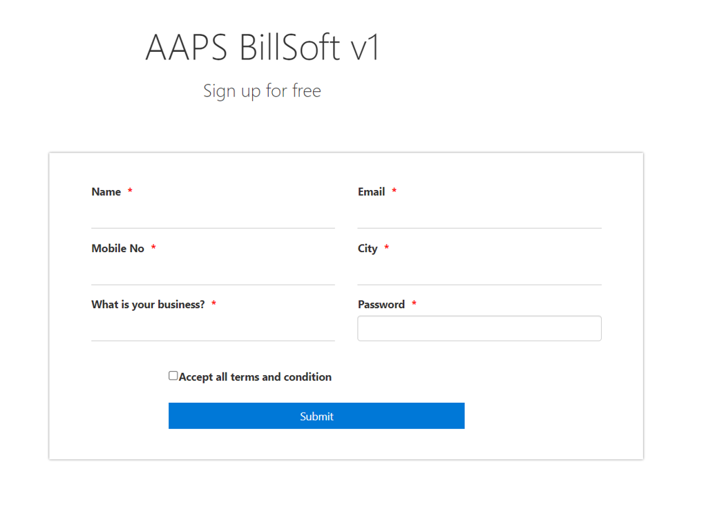
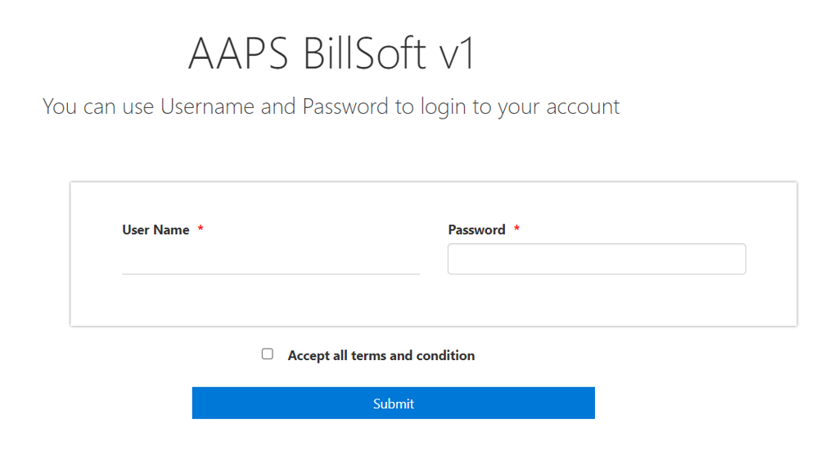
Sign up
Login

Slide 9
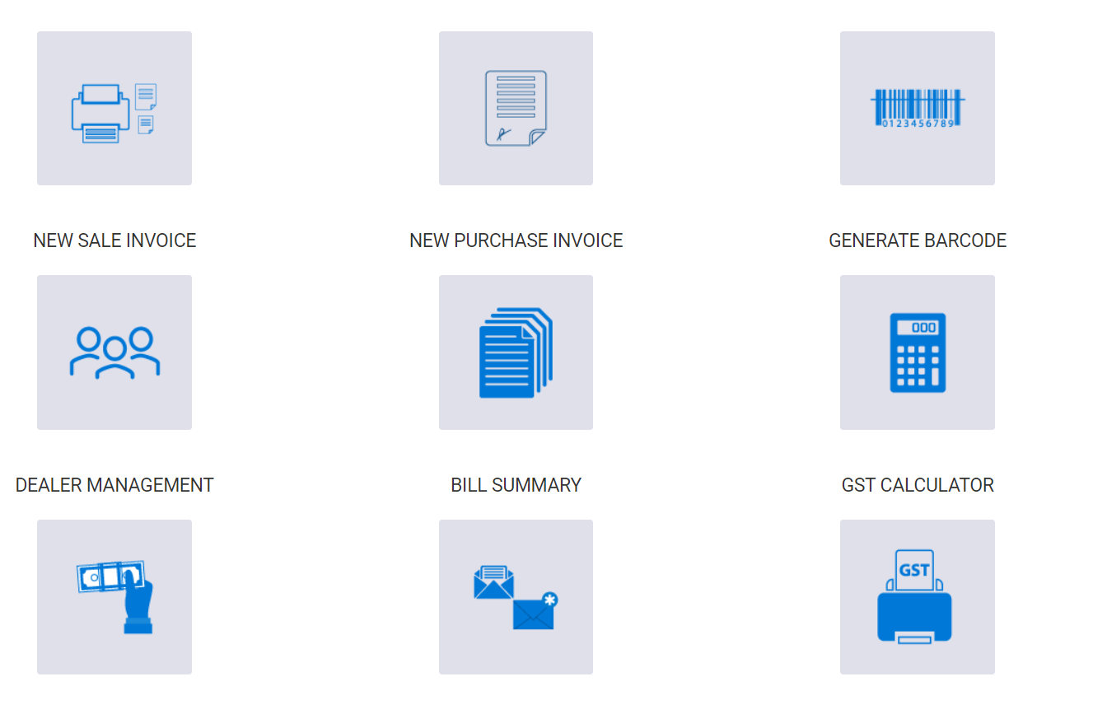
Menu

Slide 10
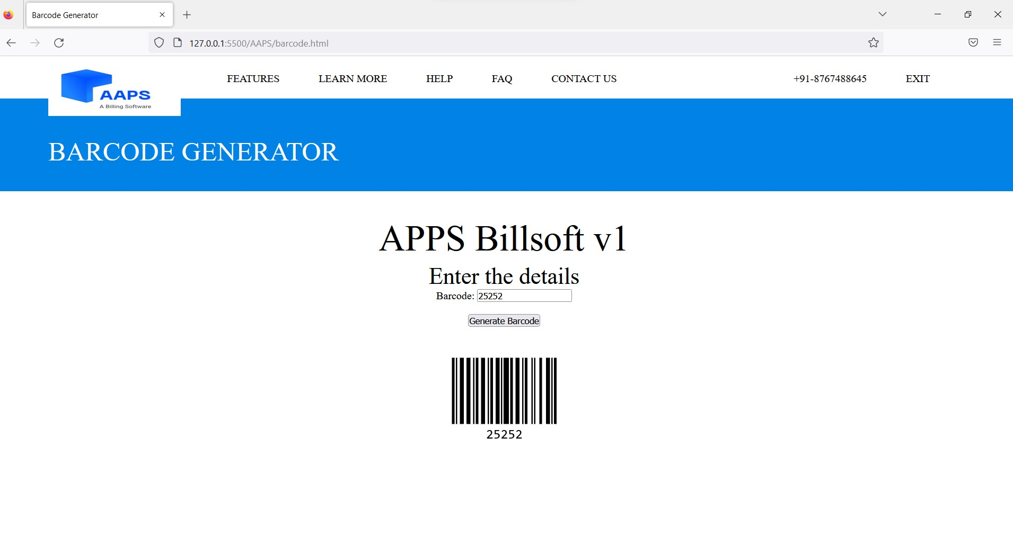
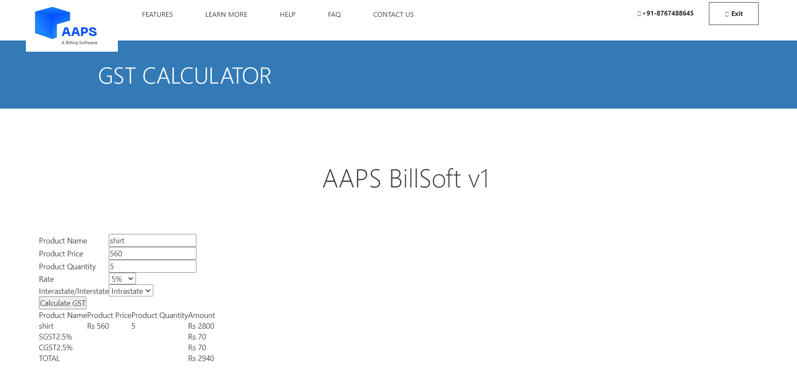
Barcode Generator
GST Calculator

Slide 11
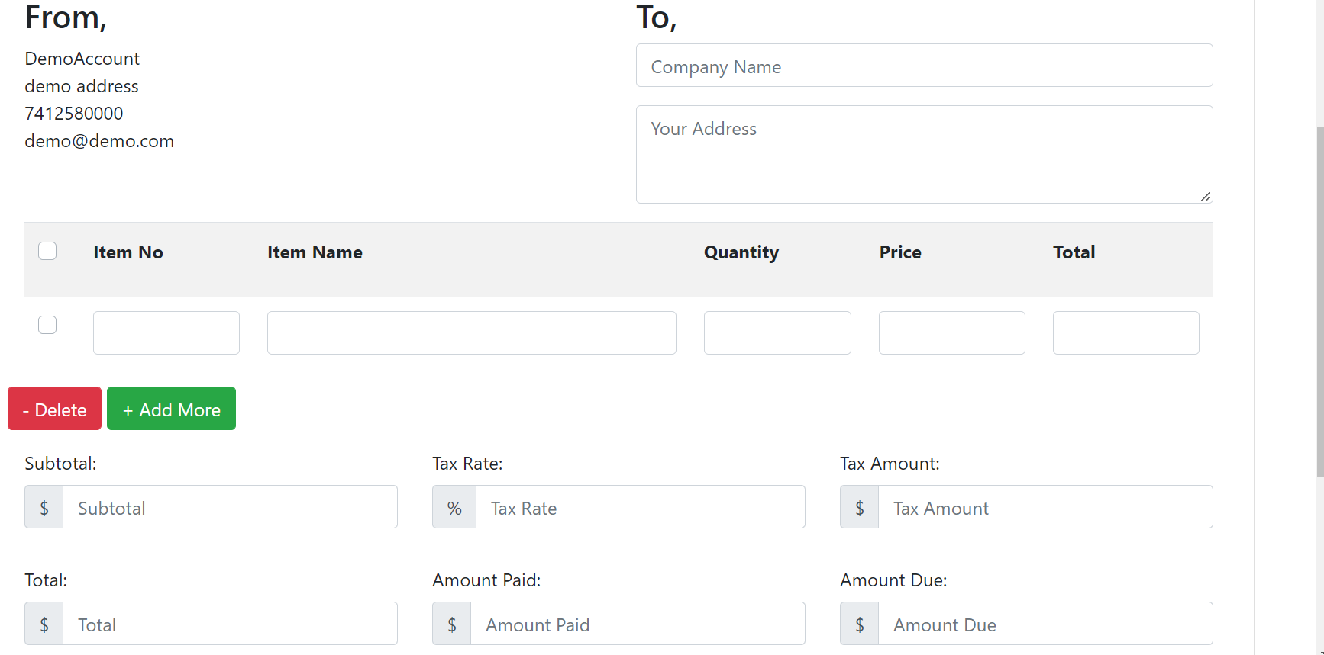
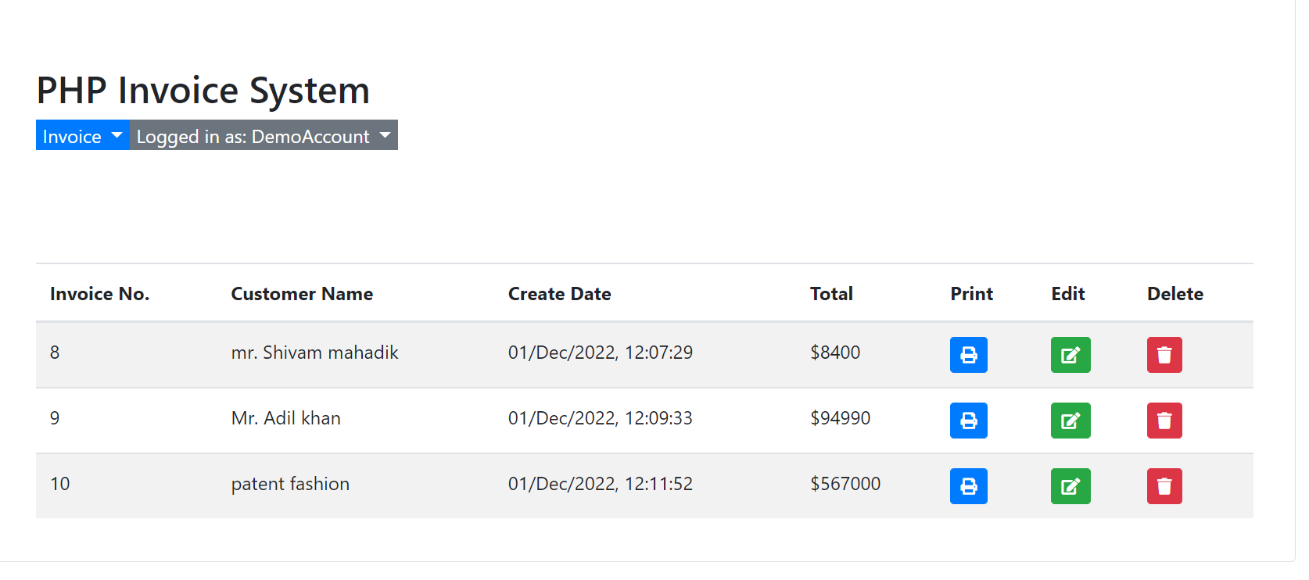
New
Sale invoice
Invoice
list

Slide 12
03.
Conclusion & Future work

Slide 13
Conclusion
AAPS is billing platform developed using following technologies
Front End: HTML, CSS, Bootstrap, JavaScript
Back End: JavaScript, MySQL, PHP

Slide 14
Future works
SMS & Email
Bill Summary
Its helps you in better communication with clients
It give you summary of all the bills of the day\month\year
GSTR Report
Mobile App
generate various GSTR reports like GSTR-1, GSTR-3B
Will be available on mobile

Slide 15
THANKS
SE CMPN-B
Adil Khan - 21102B0039
Atharva Ingole - 21102B0012
Pradip Garhwal- 21102B0010
Shivam Mahadik-21102B0003

Slide 16
AWESOME WORDS

